Slide 1

Study of Different Survey Methods

Slide 2

Primary classification of Surveying
Surveying is the field of applied science and engineering that deals with spatial information about positions of point on, above or below the earth’s surface.
Surveying is primarily divided into two types considering the curvature of earth’s surface.
Plane Surveying
Geodetic Surveying

Slide 3
Primary Divisions of Surveying
Plane Surveying
The plane surveying is that type of surveying in which earth surface is considered as a plane and the curvature of the earth is ignored.
In such surveying a line joining any two stations is considered to be straight.
The triangle formed by any three points is considered as a plane triangle, and the angles of the triangle are considered as plain angles.
Surveying is carried out for a small area of less than 250 km² .
It is carried out by local or state agencies like Irrigation department, Railway department.

Slide 4

Primary Divisions of Surveying
Geodetic Surveying
The geodetic Surveying is that type of surveying in which the curvature of the earth is taken into account.
It is generally extended over larger areas.
The line joining any two stations is considered as curved line.
The triangle formed by any three points is considered to be spherical and the angles of the triangle are considered to be spherical angles.
Geodetic surveying is conducted by the Survey of India Department and is carried out for a larger area exceeding 250 km²

Slide 5
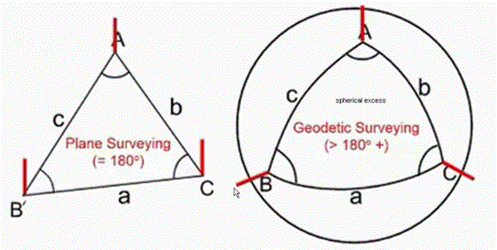

Plane surveying& Geodetic surveying

Slide 6
Difference between plan
surveying and geodetic
surveying
No. | Plan surveying | Geodetic surveying
1. | The earth surface is considered as a plane surface. | The earth surface is considered as a curved surface
2. | The curvature of earth surface is ignored. | The curvature of earth surface is taken in account.
3. | Line joining any two points is considered to be straight. | Line joining any two points is considered to be curve.
4. | The triangle formed by any three points is considered as a plane triangle. | The triangle formed by any three points is considered as a spherical triangle.
5. | The angle of triangle is considered as plane angle. | The angle of triangle is considered as spherical angle.
6. | Carried out for a small area <250km² | Carried out for a large area >250km²

Slide 7
Fundamental Principal of Surveying
Two basic principles of surveying
Always work from the whole to the part
To locate a new station by at least two measurement form fixed reference points

Slide 8
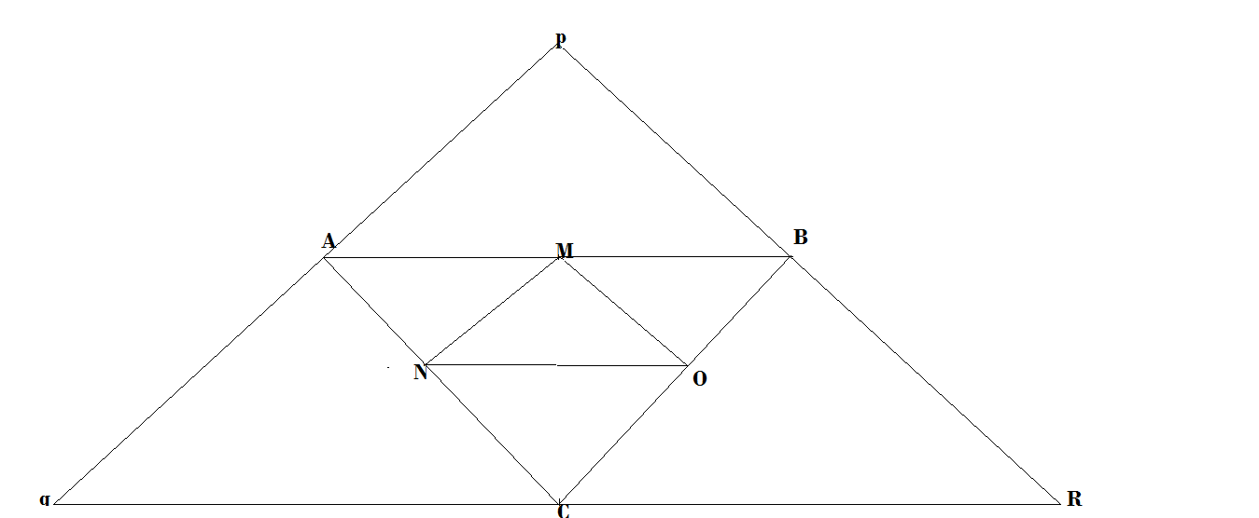
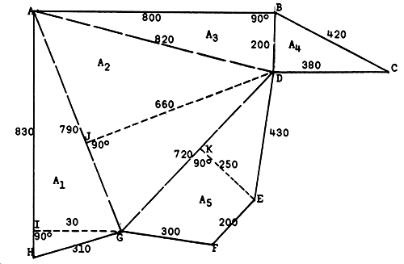
i. Always work from the whole to the part
The entire area or a very large area (town, field) is to be surveyed first.
This main framework is in the form of polygons or triangles.
The main framework is further subdivided into smaller areas for detail surveying.
This principle prevents the accumulation of errors in the surveying and localizes the errors of measurement.

Slide 9
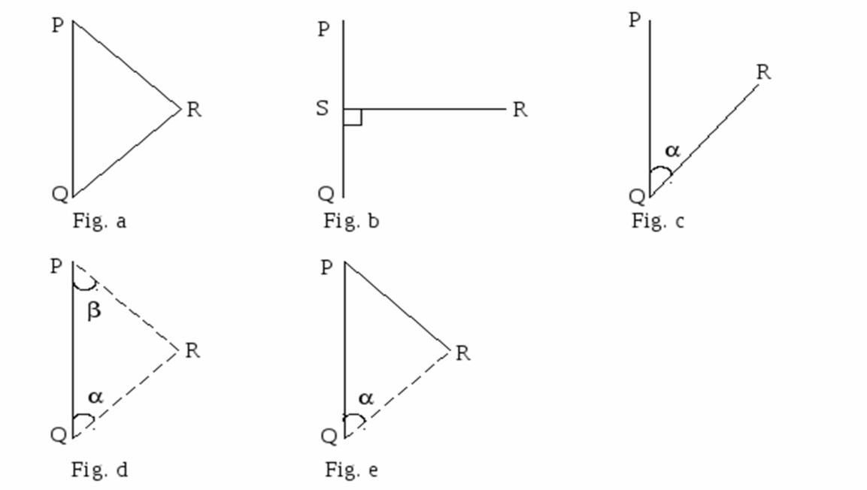
ii. To locate a new station by at least two measurement form fixed reference point
If positions of ‘P’ and ‘Q’ are known and position of ‘R’ is to be located it can be done by:
Two lengths ‘PR’ and ‘QR’ (fig a)
Perpendicular distance ‘RS’ and distance ‘QS’ (fig b)
Angle at ‘Q’ and length ‘QR’ (fig c)
Angle at ‘Q’ and ‘P’ (fig d)
Angle at ‘Q’ and length ‘PR’ (fig e)

Slide 10
Classification of Surveying
Based on Instrument
Based on Methods
Based on Purposes
Based on nature of field

Slide 11
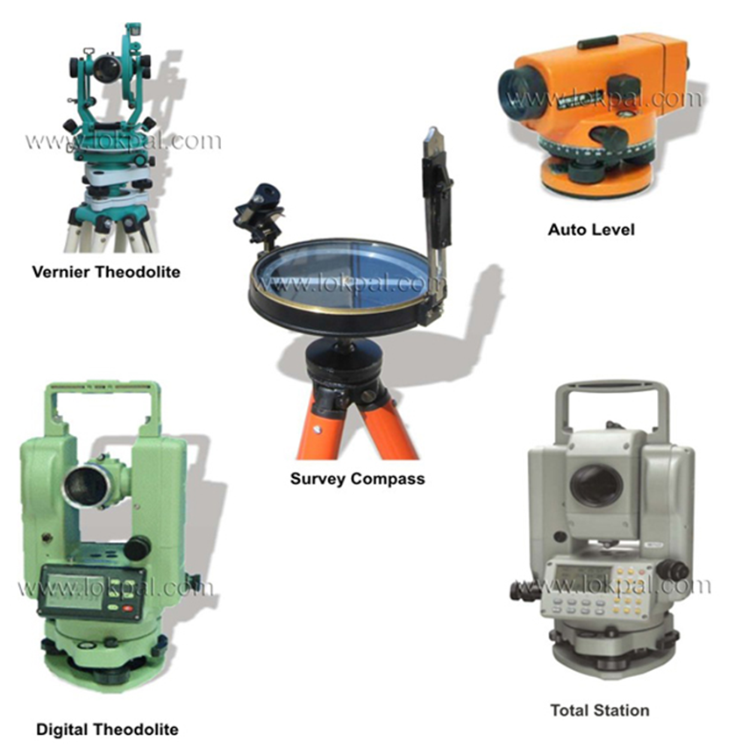
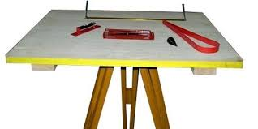
Classification based upon Instrument
Chain Survey
Compass Survey
Chain and Compass Surveying
Plane Table Survey
Theodolite Survey
Tachometry Survey
Leveling Survey
Photogrammetric Survey
EDM Survey
Classification based on methods
Triangulation
Traversing
Trilateration

Slide 12

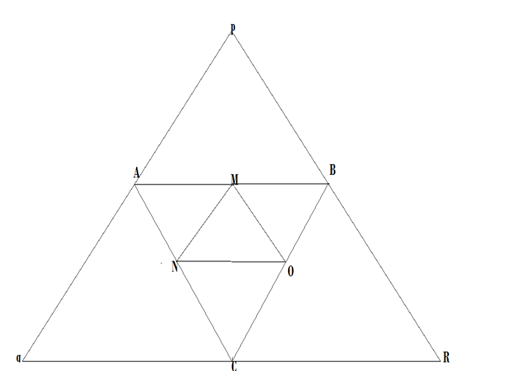
Triangulation
Triangulation is based on the trigonometric proposition that if one side and two angles of a triangle are known, the remaining sides can be computed

Slide 13
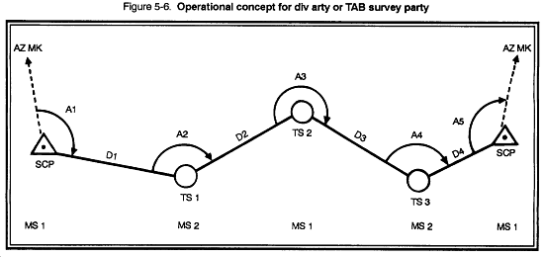
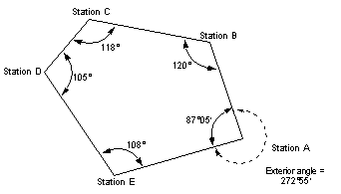
Traversing
Type of survey in which a number of connected survey lines form the framework and the directions and lengths of the survey lines are measured with the help of angle measuring instrument and Tape.
Open Traverse
Closed Traverse

Slide 14
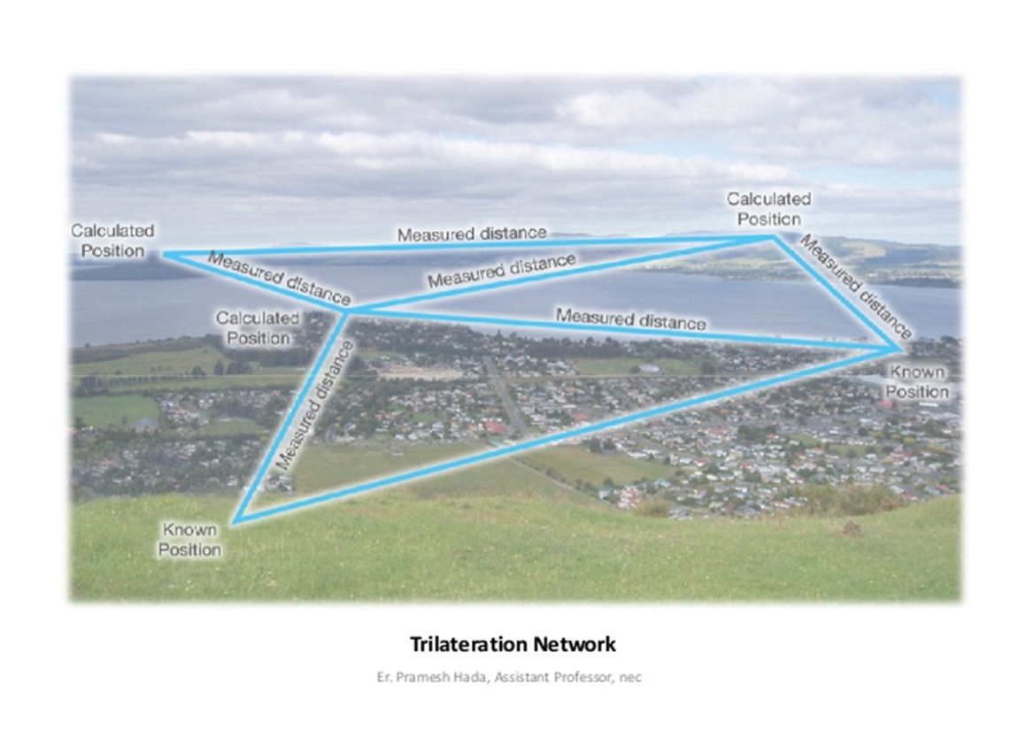
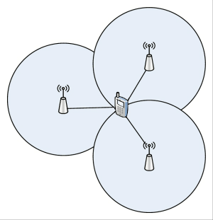
Trilateration
Trilateration is the process of determining absolute or relative locations of points by measurement of distances, using the geometry of triangles.
In contrast to triangulation, it does not involve the measurement
of angles.
GPS is based on
Trilateration.

Slide 15
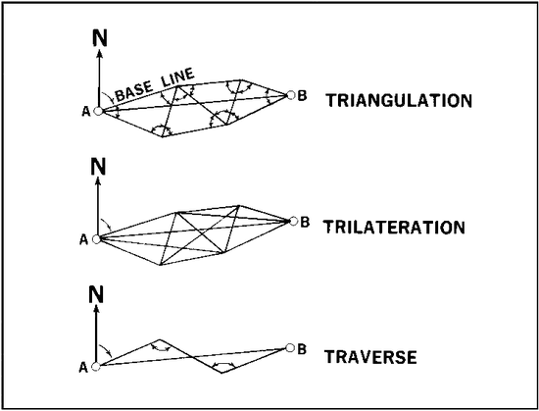

Slide 16
Scale and R.F.
Scale: The scale of map or drawing is the proportion which every distance on map or drawing bears to the corresponding distance on the ground.
Representative Fraction (R.F.): It is ratio of map distance to corresponding ground distance.

Slide 17
Representative Fraction (R.F.)
Definition :- when a scale is represented by a fraction whose numerator is invariably unity, it is called a representative fraction.
To form the RF , both the numerator and the denominator must be reduced to the same denomination.
Scale 1 cm = 1 km
RF 1: 100,000 (1cm = 100000cm)

Slide 18
Type | Representative Fraction (RF) | Scale
Geographical map | 1: 16000000 | 1 cm = 160 km
Topographical map | 1: 250000 | 1 cm = 2.5 km
Location map | 1: 500 to 1: 2500 | 1 cm = 5m to 25 m
Forest map | 1: 25000 | 1cm = 0.25 km
Cadastral map | 1: 1000 to 1: 5000 | 1 cm = 10 to 50 m

Slide 19
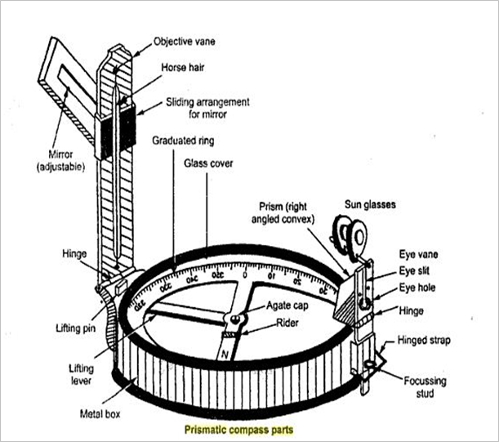
Prismatic compass
Parts of prismatic Compass
Needle
Graduated ring
Eye vane
Object vane
Prism
Prism cap

Slide 20
Bearings
The bearing of a line is the horizontal angle which it makes with a reference line(meridian).
Depending upon the meridian , following are the type of bearings :
1) True Bearing: The true bearing of a line is the horizontal angle between the true meridian and the survey line. The true bearing is measured from the true north in the clockwise direction.
2) Magnetic Bearing: The magnetic bearing of a line is the horizontal angle which the line makes with the magnetic north.
3) Arbitrary Bearing: The arbitrary baring of a line is the horizontal angle which the line makes with the arbitrary meridian.

Slide 21
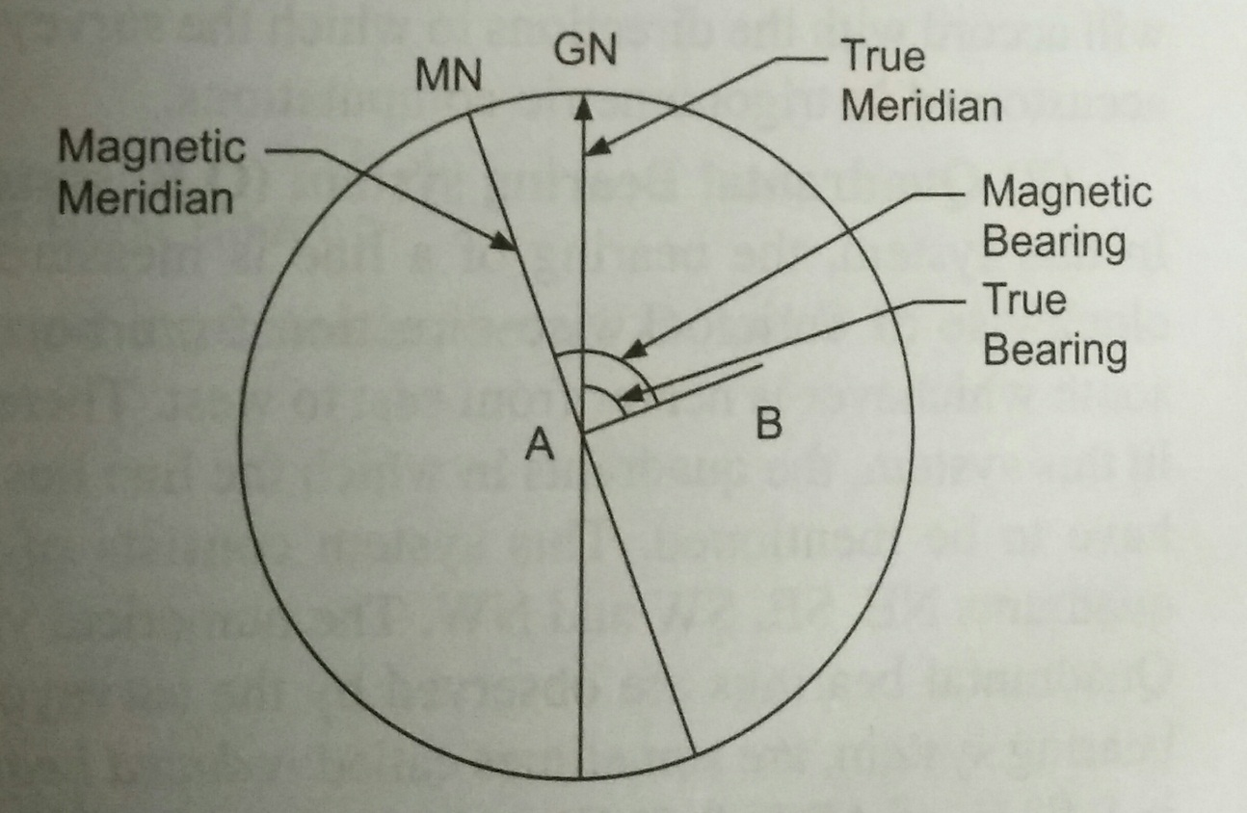
A line passing through
the geographical North
pole, geographical South
pole and any point on the
surface of earth is known as ‘True/ Geographical Meridian’.
Angle between true meridian and a line is known as True Bearing.
The direction indicated by freely suspended and properly balanced magnetic needle is called ‘Magnetic meridian’.
The angle which a line makes with magnetic meridian is called as ‘Magnetic Bearing’.

Slide 22
Observing Bearing of Line
Consider a line AB of which the magnetic bearing is to be taken.
By fixing the ranging rod at station B we get the magnetic bearing of needle with respect to north pole.
The enlarged portion gives actual pattern of graduations marked on ring.
NORTH
OBJECT B
180
90
A
270
0
LINE OF SIGHT
SOUTH

Slide 23
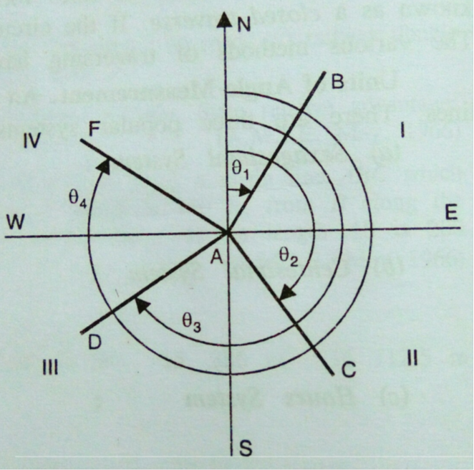
Whole Circle Bearing
Whole Circle Bearing System (W.C.B):- The bearing of a line measured with respect to magnetic meridian in clockwise direction is called magnetic bearing and its value varies between 0ᴼ to 360ᴼ.

Slide 24
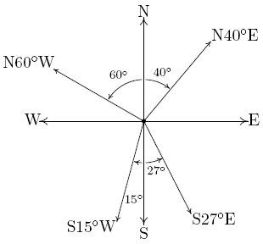
Quadrantal Bearing
Quadrantal Bearing System (Q.B):- In this system, the bearing of survey lines are measured with respect to north line or south line which ever is the nearest to the given survey line and either in clockwise direction or in anti clockwise direction.
When the whole circle bearing is converted into Quadrantal bearing, it is termed as “REDUCED BEARING”. The reduced bearing is similar to the Quadrantal bearing.

Slide 25
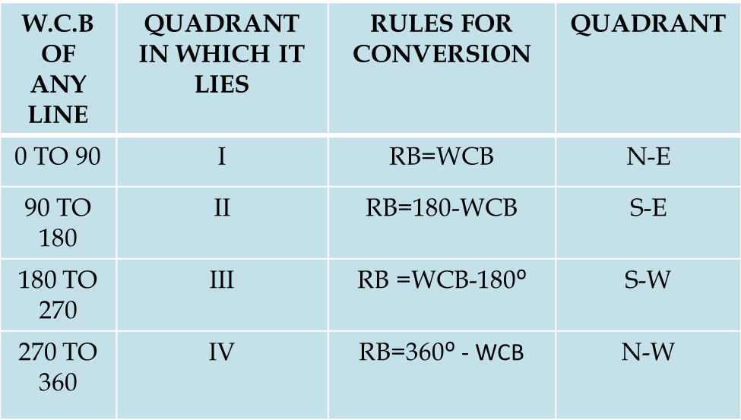
Whole circle bearing and Reduced Bearing

Slide 26
Fore bearing and Back bearing and computation of angles
The bearing of a line measured in the forward direction of the survey lines is called the ‘fore bearing’(F.B.) of that line
The bearing of a line measured in direction backward to the direction of the progress of survey is called the ‘back bearing’(B.B.) of the line.

Slide 27
FB of AB = θ1(from A to B)
BB of AB= θ2(from B to A)
Remembering following points:
In the WCB system ,the differences between the FB and BB should be exactly 180˚. Remember the following relation :
BB = FB + 180˚/ FB - 180˚
+ is applied when FB is <180˚
- is applied when BB is >180˚
2) In the reduced bearing system the FB and BB are numerically equal but the quadrants are just opposite.
NORTH
NORTH
B
(FORE BEARING)
θ2
θ1
(BACK BEARING)
A

Slide 28
Computation of Angles
Observing the bearing of the lines of a closed traverse, it is possible to calculate the included angles, which can be used for plotting the traverse.
At the station where two survey lines meet, two angles are formed-an exterior angles and an interior angles. The interior angles or included angle is generally the smaller angles(<180ᴼ).
B
A
C
D

Slide 29
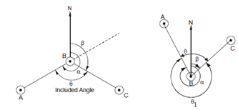
Included angle and excluded angle
AT STATION B, FB of BC and BB of AB were measured. Difference of these two bearing give included angle B.
AT STATION B , BB of AB and FB of BC were measured. Difference of these two bearing will give you exterior angle B.

Slide 30
Example 1
The following are bearings taken on a closed compass traverse. Compute the included angles and correct them for observational errors. Determine the correct bearings of the lines.
Line | Fore Bearing | Back Bearing
AB | 45˚ 30’ | 225˚ 30’
BC | 193˚ 30’ | 14˚
CA | 337˚ | 156˚ 30’

Slide 31
Example 2
The following are bearings taken on a closed compass traverse. Compute the included angles and correct them for observational errors. Determine the correct bearings of the lines.
Line | Fore Bearing | Back Bearing
AB | 120˚ | 300˚
BC | 60˚ | 246˚
CD | 318˚ | 136˚
DA | 200˚ | 16˚

Slide 32
Example 3
The following are bearings taken on a closed compass traverse. Compute the included angles and correct them for observational errors. Determine the correct bearings of the lines.
Line | Fore Bearing | Back Bearing
AB | 71˚ 05’ | 250˚ 20’
BC | 110˚ 20’ | 292˚ 35’
CD | 161˚ 35’ | 341˚ 45’
DA | 220˚ 50’ | 40˚ 05’
EA | 300˚ 50’ | 121˚ 10’

Slide 33
Homework Example 1
The following are bearings taken on a closed compass traverse. Compute the included angles and correct them for observational errors. Determine the correct bearings of the lines.
Line | Fore Bearing | Back Bearing
AB | 328˚ | 148˚
BC | 32˚ | 210˚30’
CA | 182˚ | 3˚

Slide 34
Example 2
The following are bearings taken on a closed compass traverse. Compute the included angles and correct them for observational errors. Determine the correct bearings of the lines.
Line | Fore Bearing | Back Bearing
AB | 93˚ | 268˚
BC | 37˚30’ | 220˚
CD | 260˚ | 80˚
DA | 160˚ | 342˚30’

